Slide 1
House Sales in King County Regression
The main objective of the project was to find the best suited model for the given data set.

Slide 2
Project Participants
Saroj Dogra
Geethan B
Anoop Kumar
Muzzammil Mulla
Shravan Pandey

Slide 3
Contents:
Process
Libraries Imported
Difference of r^2 value before and after removing multicollinearity
Model r^2 score Visualization
Insights
Challenges

Slide 4
Process:
Imported Data Set.
EDA
Used Feature Engineering to manipulate the data and extracted the unwanted columns.
Scaling through Standardization.
Encoding through One Hot Encoding.
Splitting the training and testing values.
Train multiple models like Linear regression, Decision Tree, Random Forest, and SVR.
Check the performance of models and find out which is the best model.
After Multi-collinearity remove columns with high multi-collinearity and re-run all the models and check the performance.

Slide 5
PROCESS
Imported Data Set.
Feature Engineering to manipulate the data and extracted the unwanted columns.
Scaling through Standardization
EDA
Encoding through One Hot Encoding.
Splitting the training and testing values
Train multiple models like Linear regression, Decision Tree, Random Forest, and SVR.
Check the performance of models and find out which is the best model.

Slide 6
Libraries Imported
Pandas
Sklearn.preprocessing – Encoding , Scaler
Sklearn.model_selection – Linear
Matplotlib
Seaborn
Sklearn.tree – Decision Tree
Metrics – r^2 score
Sklearn .ensemble – Random Forest
Sklearn.svm – Support Vector Regressor

Slide 7
Difference of r^2 value before and after removing multicollinearity
Model | Before | After
Linear Regression | 0.859 | 0.587
Decision Tree | 0.782 | 0.603
Random Forest | 0.894 | 0.606
SVR | -0.067 | -0.068

Slide 8
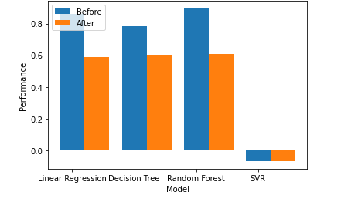
Model r^2 score Visualization

Slide 9
Insights:
The r^2 value had difference after removing or dropping the columns.
Support Vector Regressor had negative values.
The Random Forest values and Grid Search CV values where same.
Had more columns with high multicollinearity.
Found that Random Forest was the best suited model for the data.

Slide 10
Challenges:
Had trouble finding chi-square values.
Everyone got different r^2 score values and we had chosen the best one.

Slide 11
Conclusion:
We faced a few problems while solving .
Had gained experience solving such data sets.
Everyone shared there inputs and were active .
We learned about team building and collective working in a real environment.
.

Slide 12
Thank You

